Slide 1
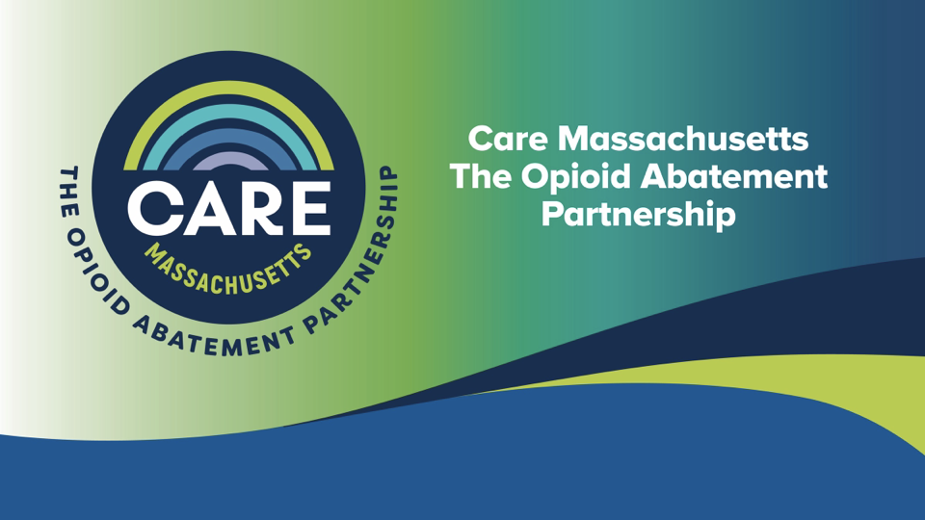

Slide 2

Background – Opioid abatement settlement
In July 2021, the MA Attorney General announced the state’s participation in a $26 billion nationwide resolution with opioid distributors AmerisourceBergen, Cardinal and McKesson and opioid manufacturer Johnson & Johnson
More settlements and bankruptcies followed
Resolved claims that these companies engaged in misconduct that enabled and perpetuated vast increases in opioid over-dispensing and diversion (e.g., unfair and deceptive sales tactics, failed to monitor suspicious orders, avoided responsibility)
These resolutions are expected to bring more than $921 million into Massachusetts for prevention, harm reduction, treatment, and recovery
Notes:
Under the terms of the state’s approved State-Subdivision Agreement:
40% of abatement funds coming into Massachusetts under statewide opioid settlements will be allocated to municipalities to expend on abatement strategies developed with input from public health experts, municipal leaders, and families affected by the crisis
60% of the abatement funds will be allocated to the state’s Opioid Recovery and Remediation Fund (ORRF) to fund additional prevention, harm reduction, treatment, and recovery programs throughout Massachusetts

Slide 3






Enhance Opioid Use Disorder Treatment
Municipal Strategies
Municipal Strategies
Support People In Treatment & Recovery
Facilitate Connections to Care
Promote Harm Reduction
Needs of Criminal-Justice-Involved Persons
Support for Pregnant or Parenting Woman
Prevent Misuse of Opioids & Implement Prevention Education
Massachusetts Department of Public Health | mass.gov/dph
‹#›

Slide 4

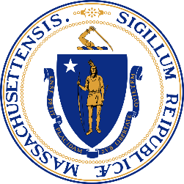
We encourage you to:
Pool Your Funding
 | Build regional coalitions! Work with neighboring municipalities to build more substantive programming through pooled funding.
Focus on Specific Local Needs
 | Build on the statewide ORRF work by focusing your investments on specific local needs. ORRF and municipal investments should compliment each other.
Use the Resources Available
 | Put some of the funding toward putting a plan together, hiring staff, building capacity, etc. Lean on Care Mass for training and technical assistance.
Center Lived Experience + Equity
 | Listen to your community for suggestions on key investments. Prioritize investments in community-based programming rather than the institutions that contributed to this crisis.

Slide 5
Opioid Abatement Settlement Estimated Payments
Range of annual payments for the town of Milton
  $70,000 to $99,000 *estimated annual payment based on current settlements
  This is an estimated range because there are still some settlements which have not been confirmed yet.
    This information can be found on the Massachusetts Office of the Attorney General’s website https://www.mass.gov/lists/municipal-abatement-payments
Notes:
Under the terms of the state’s approved State-Subdivision Agreement:
40% of abatement funds coming into Massachusetts under statewide opioid settlements will be allocated to municipalities to expend on abatement strategies developed with input from public health experts, municipal leaders, and families affected by the crisis
60% of the abatement funds will be allocated to the state’s Opioid Recovery and Remediation Fund (ORRF) to fund additional prevention, harm reduction, treatment, and recovery programs throughout Massachusetts

Slide 6
Care Massachusetts Training and Technical Assistance
Care Massachusetts is working collaboratively with cities and towns across the state, providing resources and technical assistance related to the opioid abatement funds.
Email: abate@jsi.com
Visit: www.caremass.org
Call: (617) 385-3655

