Slide 1
Community Health Assessments
A Primer
By Laurie Stillman, MMHS
May 9, 2022

Slide 2
What is a CHA? (vs. CHNA)
A systematic way of diagnosing health status, needs, assets and resources by:
  Gathering statistical data
  Soliciting perspectives from community members through surveys, interviews and conversations
  Identifying community strengths and resources
A report containing baseline data that can be used to identify needs and assets, establish priorities, as well as track changes over time
A process in which the health department, together with community members/partners, get invested in planning change)
Notes:
So what exactly do we mean when we refer to a community health needs assessment?
A CHNA is a systematic way of identifying needs and resources by:
-Gathering statistical data
-Soliciting perspectives from community members
-Collecting information about community resources
Once complete, you have a product in which your baseline data collected can be used to track and measure changes, and it’s also a process whereby you work collaboratively with community members, partners, and/or coalitions to address issues affecting their well being. Community members are seen as expert, equal partners in this process.

Slide 3
Why do we do them? Because they…
Make known needs and challenges of residents
Create awareness of particular community concerns or issues
Pinpoint most vulnerable & at-risk sub populations
Identify resources & organizations that may help meet needs
Help establish program priorities, goals, and objectives
Provide a baseline for an evaluation
Provide a systematic basis for which organizational decisions are made
Serve as a public relations tool for health department
Public health department accreditation requirement & ACA requirement for hospitals

Slide 4
What do we learn?
The main health concerns and challenges in the community as a whole & in specific populations
The main reasons for these health challenges and concerns, & uncovered disparities
The strengths & assets in the community
Where to intervene thru a Community Health Improvement Plan
Notes:
CHNAs help inform us in several different ways. They tell us:
-What the main health concerns are in the community
-The main reasons for these health concerns
-The strengths/assets in the community
-Where we might want to intervene to create change

Slide 5
Community Health Planning
CHA and CHIP
Assessment Planning
Data Collection and Analysis
Strategic Planning
Project Management Plan
Notes:
There are many different assessment models you can use when conducting a CHNA, which I’ll discuss a little later. No matter which assessment model you use, there are three overall phases to conducting a CHNA. They include:
Planning and organizing for your assessment, or the pre-assessmennt phase.
Data collection and analysis, or the assessment phase
And finally, once you’ve completed your assessment, you begin program action planning, or the post-assessment

Slide 6
Social Determinants of Health
The conditions in the environments where people are born, live, learn, work, play, worship, and age that affect a wide range of health, functioning, and quality-of-life outcomes and risks*.
Financial Insecurity
Food Insecurity
Housing Burden and Affordability
Educational Attainment
Access to Care- Oral, Medical, Behavioral Health
Transportation
Social Envt and Civic Engagement
Racism/Discrimination
Physical/Built Environment
Healthy People 2030

Slide 7
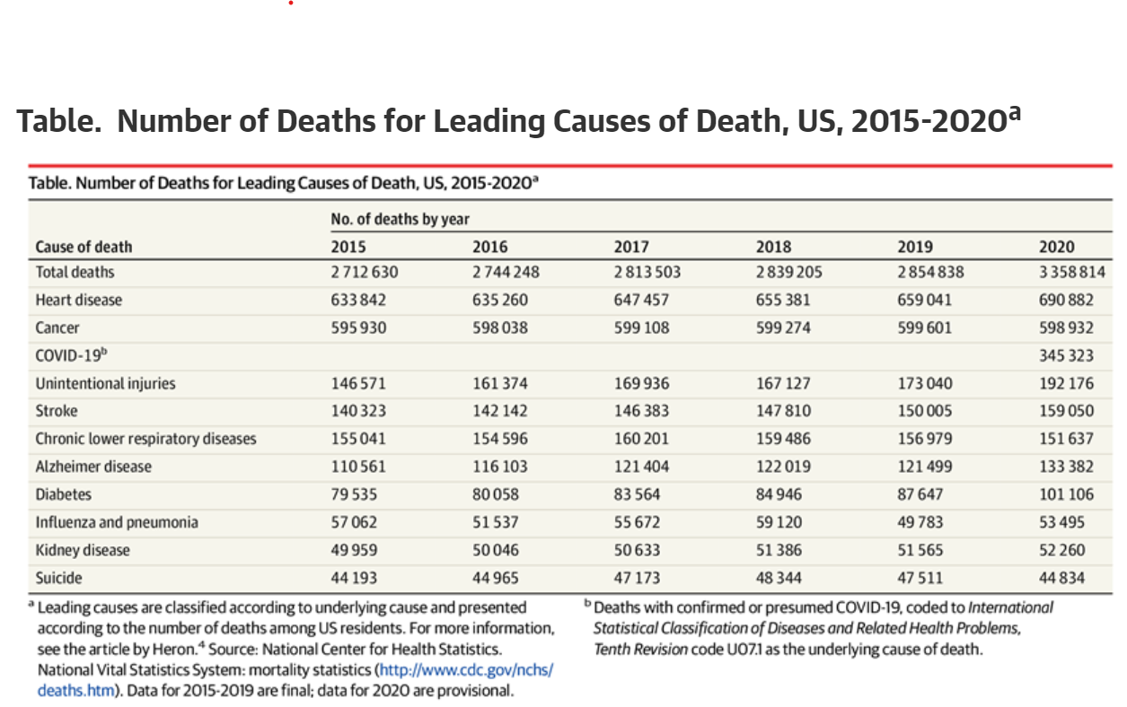
Leading Causes of Death in US

Slide 8
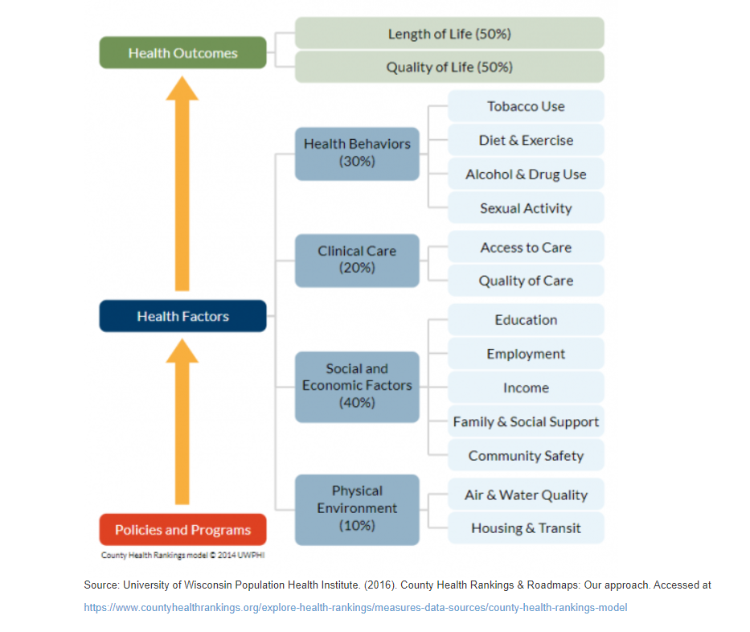
Role of Prevention

Slide 9
Understanding Health Disparities
Health disparities include the following:
Mortality.
Life expectancy.
Burden of disease.
Mental health.
Uninsured/underinsured.
Lack of access to care. (1)
Health Disparities in populations
Race and ethnicity.
Gender.
Sexual identity and orientation.
Disability status or special health care needs.
Geographic location (rural and urban)
HealthyPeople.gov

Slide 10
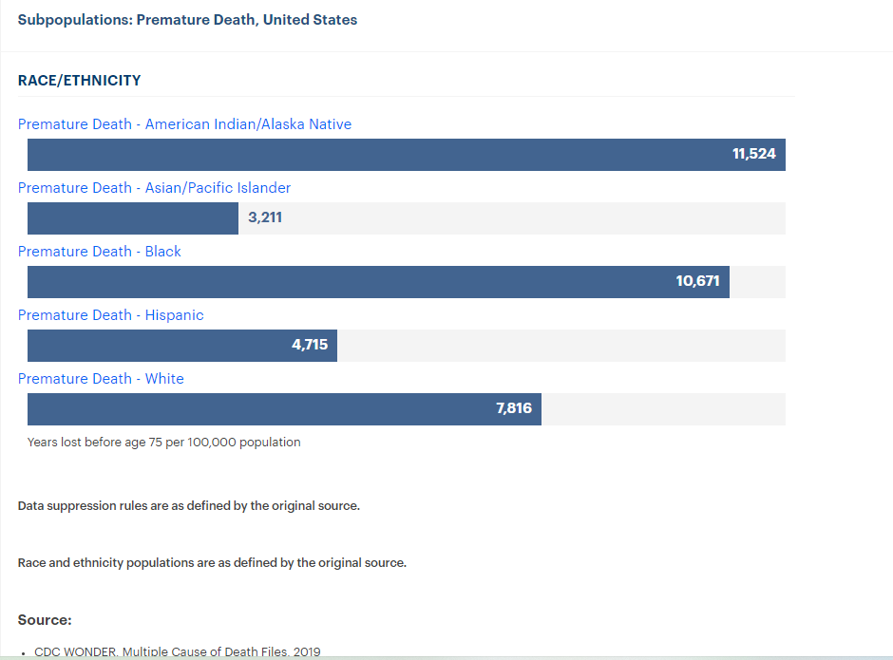
Disparities in Premature Death

Slide 11
Health Disparities in Chronic Diseases and Premature Death
Health disparities exist among the common chronic diseases, such as hypertension, diabetes mellitus, HIV/AIDS, cancer, cardiovascular disease, and obesity, with ethnic minorities and the poor having higher incidence or worse outcomes.(2)
People of color face higher rates of diabetes, obesity, stroke, heart disease, and cancer than whites. In the case of diabetes, the risk of being diagnosed is 77 percent higher for African Americans and 66 percent higher among Hispanics, than for whites. Asian Americans are at twice the risk of developing diabetes than the population overall.

Slide 12
Health Disparities vs. Health Equity
Health Disparities
Health Equity
Avoidable differences in health status that occur by gender, race or ethnicity, education or income, disability, living in rural localities, or sexual orientation.
Attainable conditions where everyone has the opportunity and right to be as healthy as possible.

Slide 13
Collecting Data is a Methodical Process
What are the problems, why do they occur, who is at most risk, what are the solutions, what community assets and strengths exist to help address them?
Types
Census
Surveys
Key Informant Interviews
Focus Groups
Online reports from federal, state and other sources
Public health & health care data (hospitals, state public health dept, insurance claims)
Public & institutional records (first responders, schools,, district attorney, courts, community planning and environmental organizations
CBOs, local government, faith organizations
Rationale
Demographics, Social Determinants of health (SDOH)
Risk behaviors, beliefs, attitudes, SDOH
Community needs and assets, solutions
Group perspectives & ideas of like individuals, health equity, solutions to problems
Statistical data on preventable illnesses, injuries & behavioral health; health disparities
Statistical data, Population health status
Challenges, assets, SDOH, physical environment
Asset mapping

