Slide 1

TOWN OF MILTON HEALTH DEPARTMENT
WELCOME!
Community Health Advisory Group

Slide 2
Community Health Assessment Players Roles and Responsibilities
CHA Director:
Caroline Kinsella
Staff/Operations Group:
Caroline Kinsella, Laura Dellechiaie, Laurie Stillman, Stormy Leung, Rachel Brase, Amber Mullen
CHA Community Advisory Group:
Anita Albright, Griffin Angus, Deborah Greene, Dr. Marian Hannan, Dr. Linda Hudson, Stefano Keel, Kristin Kociol, Dr. Patricia Janulewicz Lloyd, Jennifer Lo, Laureane Marquez, Deborah Milbauer, Priscilla Neves, Dr. Jonathan Pincus, Christine Stanton, Bruce Talanian

Slide 3
CHA GUIDING PRINCIPLES
Examine challenges, opportunities, and strengths to promote a healthy Milton
Use highest quality quantitative and qualitative data
Use both evidence based and innovative practices to address health challenges
Encourage proactive, broad, and diverse multi-sector community engagement
Commit to understanding health disparities in our community and use a “health equity lens” to address them
Focus on preventable illnesses and injuries
Ensure maximum transparency and communications to foster accountability and community engagement
Engage in evaluation to promote quality improvement

Slide 4
Community Health Assessments
A Primer
By Laurie Stillman, MMHS
June 22, 2022

Slide 5
What is a CHA? (vs. CHNA)
A systematic way of diagnosing health status, needs, assets and resources by:
Gathering statistical data
Soliciting perspectives from community members through surveys, interviews and conversations
Identifying community strengths and resources
A process in which the health department, together with community members/partners, get invested in planning change
Notes:
So what exactly do we mean when we refer to a community health needs assessment?
A CHNA is a systematic way of identifying needs and resources by:
-Gathering statistical data
-Soliciting perspectives from community members
-Collecting information about community resources
Once complete, you have a product in which your baseline data collected can be used to track and measure changes, and it’s also a process whereby you work collaboratively with community members, partners, and/or coalitions to address issues affecting their well being. Community members are seen as expert, equal partners in this process.

Slide 6
What do we learn?
The main health concerns and challenges in the community as a whole & in specific populations
The main reasons for these health challenges, concerns & disparities
The strengths & assets in the community
Notes:
CHNAs help inform us in several different ways. They tell us:
-What the main health concerns are in the community
-The main reasons for these health concerns
-The strengths/assets in the community
-Where we might want to intervene to create change

Slide 7
What Do We Examine
Health Conditions
Health Behaviors
Physical and Social Environments
Health Systems, Policies & Settings
Affected Populations

Slide 8
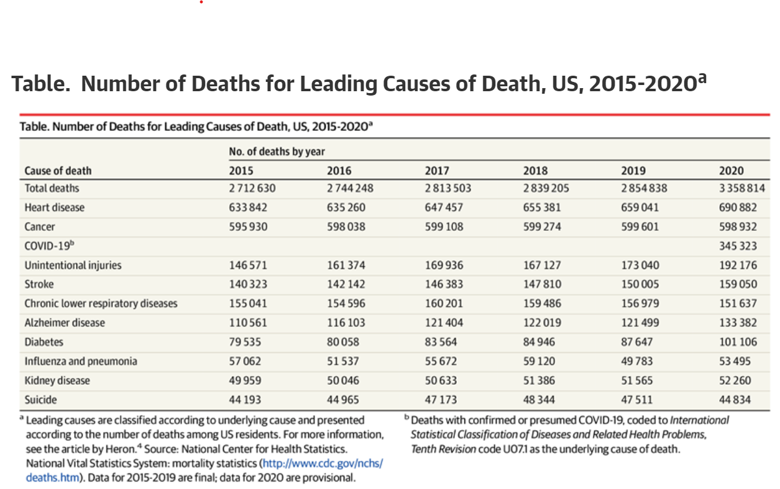
Health Conditions: Leading Causes of Death in US

Slide 9
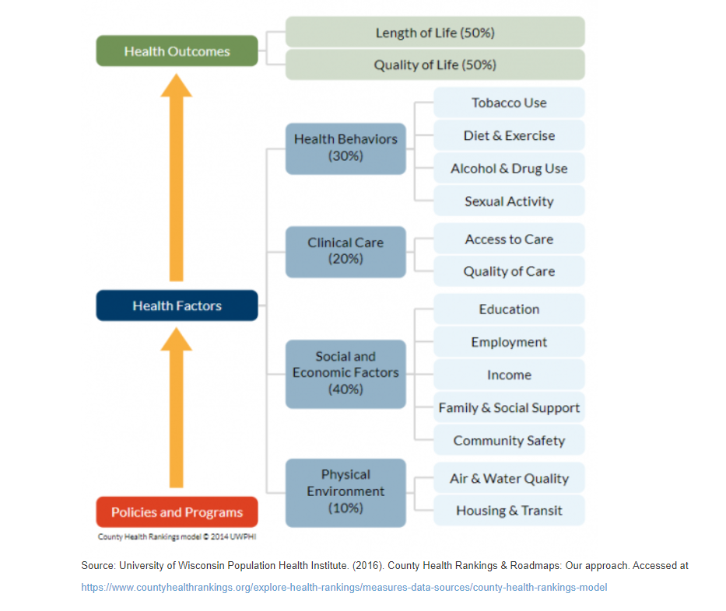
Role of Prevention

Slide 10
Social Determinants of Health The conditions in the environments where people are born, live, learn, work, play, worship, and age that affect a wide range of health, functioning, and quality-of-life outcomes and risks*.
Financial Insecurity
Food Insecurity
Housing Burden and Affordability
Educational Attainment
Access to Care- Oral, Medical, Behavioral Health
Transportation
Social Envt and Civic Engagement
Racism/Discrimination
Physical/Built Environment
Healthy People 2030
Notes:
Financial Insecurity
Food Insecurity
Housing Burden and Affordability
Educational Attainment
Access to Care- Oral, Medical, Behavioral Health
Transportation
Social Envt and Civic Engagement
Racism/Discrimination
Physical/Built Environment

Slide 11
Understanding Health Disparities
Health disparities include the following:
Mortality.
Life expectancy.
Burden of disease.
Mental health.
Uninsured/underinsured.
Lack of access to care.
Health Disparities in populations
Race and ethnicity.
Gender.
Sexual identity and orientation.
Disability status or special health care needs.
Geographic location (rural and urban)
HealthyPeople.gov

Slide 12
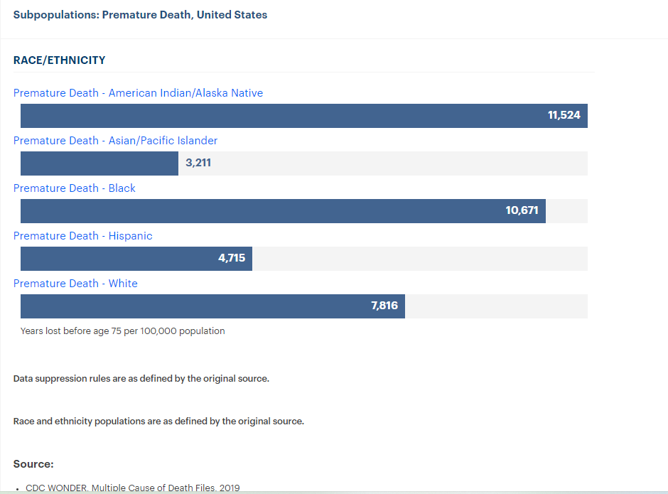
Health Disparities in Chronic Diseases and Premature Death
Health disparities exist among the common chronic diseases, such as hypertension, diabetes mellitus, HIV/AIDS, cancer, cardiovascular disease, and obesity, with ethnic minorities and the poor having higher incidence or worse outcomes.(2)
People of color face higher rates of diabetes, obesity, stroke, heart disease, and cancer than whites. In the case of diabetes, the risk of being diagnosed is 77 percent higher for African Americans and 66 percent higher among Hispanics, than for whites. Asian Americans are at twice the risk of developing diabetes than the population overall.

Slide 13
Collecting Data is a Methodical Process
What are the problems, why do they occur, who is at most risk, what are the solutions, what community assets and strengths exist to help address them?
Quantitative Data
Self Report Surveys
Records and Reports
Data collected by tests or machines
Qualitative Data
One on One Interviews
Expert Consultations
Focus Groups

Slide 14

Community Health Improvement Plan
The data we collect helps us know where to intervene through a:
This Photo by Unknown Author is licensed under CC BY-SA

Slide 15
Questions & Discussion

Slide 16
Healthy People 2030
National objectives set every 10 years by the Department of Health & Human Services
Data-driven
Equity-focused
Objectives can be divided into several categories:
Health Conditions
Health Behaviors
Populations
Settings & Systems
Social Determinants of Health

Slide 17
Populations (HP 2030)
Adolescents
Children
Infants
LGBTQ+
Men
Older Adults
Parents or Caregivers
People with Disabilities
Race/Ethnicity/Nativity
Women
Workforce

Slide 18
Health Conditions (HP 2030)
Addiction
Arthritis
Blood Disorders
Cancer
Chronic Kidney Disease
Chronic Pain
Dementias
Diabetes
Foodborne Illness
Healthcare Associated Infections
Heart Disease & Stroke
Infectious Disease
Mental Health & Mental Disorders
Oral Conditions
Osteoporosis
Overweight & Obesity
Pregnancy & Childbirth
Respiratory Disease
Sensory or Communication Disorders
Sexually Transmitted Infections

Slide 19
Health Behaviors (HP 2030)
Child & Adolescent Development
Drug & Alcohol Use
Emergency Preparedness
Family Planning
Health Communication
Injury Prevention
Nutrition & Healthy Eating
Physical Activity
Preventative Care
Safe Food Handling
Sleep
Tobacco Use
Vaccination
Violence Prevention

Slide 20
Community Demographics
The American Community Survey (ACS) is a demographics survey program conducted by the United States Census Bureau.
Administered annually to collect sociodemographic data and learn about the characteristics of local communities.
What does our population look like?
How has it changed over time?
Most of the information that we have compiled for Milton and Massachusetts is from the ACS 5-Year Estimates and includes 2010 and 2020 data.

Slide 21
ACS 5-Year Data
Age
Ancestry
Citizenship
Disability Status
Educational Attainment
Employment
Health Insurance
Housing Characteristics
Income
Language Proficiency
Marital Status
Nativity
Place of Birth
Poverty
Race & Ethnicity
Sex
Total Population
Transportation
Veteran Status

Slide 22
Limitations
There are limitations to the ACS data in regard to collecting some information that Healthy People 2030 considers important.
For example, specific information related to racial, ethnic, sexual, and gender minorities is not included.
We will need to identify supplemental data sources to ensure that the Milton community health assessment reflects this information.
Please let us know if you have ideas for or access to additional data sources!

Slide 23
Questions & Discussion
Laurie: laurie.stillman@gmail.com
Rachel: rbrase@norwoodma.gov
Amber: amullen@norwoodma.gov

