Slide 1
TOWN OF MILTON MUNICIPAL BROADBAND COMMITTEE
Presentation to the Select Board:
CTC Technology’s Report “Design and Cost Estimate for Town I-NET”
May 29, 2019

Slide 2
Committee Members
Joe Chamberlin
Mark Day
Steve Paxhia
John Sullivan

Slide 3
In this presentation
CTC Report Timeline
Broadband Committee’s Assessment
Report Methodology
What’s in the CTC Report
Network Design
Network Cost
Estimated Operating & Maintenance Costs
Construction Costs and Components
INET Benefits / Disadvantages / Opportunities
Leased Services Benefits / Disadvantages
Pole Attachment Exhibit

Slide 4
CTC Report Timeline
August/Sept 2018
Milton issues RFP for a report detailing design and cost estimate to replace the town I-NET with a town-owned, fiber optic network
October 2018
CTC Technologies wins RFP bid
January 2019
CTC delivers their report, “Design and Cost Estimate for a Town I-Net”

Slide 5
Broadband Committee’s Initial Appraisal
After reviewing CTC’s report all four members of the committee agree that the vendor met or exceeded the report’s requirements, as described in RFP
CTC’s report is comprehensive in its scope and richly detailed. Many topics (e.g. network design, financial model, condition of utility poles) are presented with valuable context, suggested avenues for further inquiry, or industry practice, making it accessible to non-experts.
The report also came with dynamic Excel-based models that Milton can use to create and analyze different construction and finance scenarios.
Finally, its thoroughness and detail will serve as a solid foundation for project planning, if Milton pursues the opportunity to create municipal broadband.

Slide 6
CTC’s Methodology
The CTC Team is comprised of network design and construction, network operations, and financial modeling experts.
CTC facilitated meetings and information collection with various town personnel, representing input from all town departments
Meetings, phone conferences, and questionnaires

Slide 7
What the report contains
Two cost estimates, one low and one high (based on network size), for network construction and operation;
Engineering assessment of the existing network;
Recommended technical solutions for new fiber network, including high-level network design;
Financial analysis, including:
- capital and operating expenses,
- Detailed estimate of payback period for bonded construction cost, expressed as monthly per-site costs per Town department;
Example of third-party pole attachment agreements in other Massachusetts municipalities

Slide 8
Network Design Assumptions
Provide fiber connectivity to 19 Town, School, and other community anchor institutions;
Route fiber paths near eight additional significant institutions that may be opportunities for future connectivity to the Town network;
Select routes that minimize construction costs associated with utility pole “make-ready” construction and/or more expensive underground construction;
Provide adequate capacity within the backbone for future uses;
Increase network resiliency through redundant connections to core network sites

Slide 9
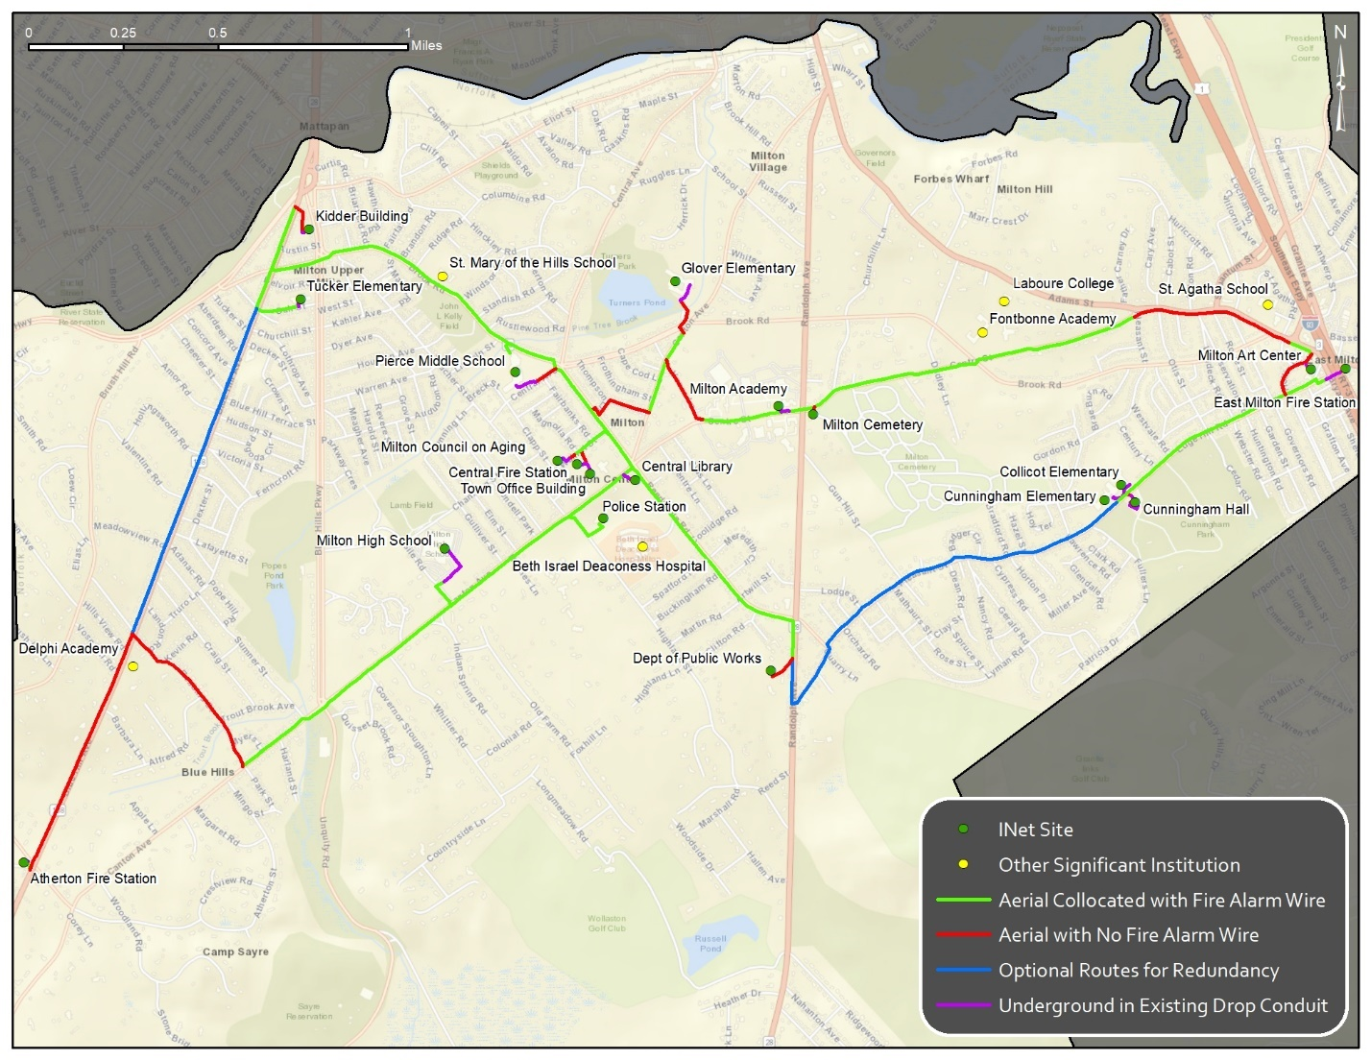

Slide 10
New I-NET: Cost Estimate
Scenario | Low-Cost Estimate | High-Cost Estimate
Baseline Network | $635,000 | $784,000
Optional Redundant Routes | 167,000 | 198,000
Total With Redundancy | $802,000 | $982,000

Slide 11
Difference between high and low cost estimates
Low cost:
essentially utilizes existing fire alarm system messenger wires, thus less make-ready work,
does not included redundant routes
High cost:
assumes all aerial construction will require make-ready work,
includes redundant routes

Slide 12
Per Site Cost (high cost estimate)
Over the course of 20 years*, network deployment, operations, maintenance, and financing will cost the equivalent of $1,000 per site per month.
For a total of 19 sites, this will cost roughly $19,000 per month, or $228,000 annually.
* 20 years is the payback period assumed for all financial modeling in the CTC report

Slide 13
New I-NET: Annual Cost Summary
Scenario | Monthly Per-Site Cost | Annual Cost *
High-Cost With Redundancy | $1,000 | $228,000
Low-Cost With Redundancy | $950 | $217,000
High-Cost Without Redundancy | $930 | $212,000
Low-Cost Without Redundancy | $890 | $203,000
* This is an all-in amount, capturing both bond repayment and estimated operating costs. The stand-alone estimated operating cost averages $109k per year, which does not take into account potential savings. Or said another way, this amount may be effectively reduced by finding savings throughout the town budget that a municipally owned network may afford us.

Slide 14
Operating and Maintenance Expenses
Model assumes:
the Town will use its existing staff to cover most labor expenses;
the Town will need to acquire a 0.5 full time-equivalent (FTE) geographic information systems (GIS) support position

Slide 15
Operating and Maintenance Expenses
Operating and Maintenance Expenses | Year 1 | Year 3 | Year 5 | Year 10
Locates and Ticket Processing | $300 | $1,100 | $1,100 | $1,100
Insurance | 25,000 | 25,000 | 25,000 | 25,000
Fiber Maintenance and Repairs | 1,600 | 6,300 | 6,300 | 6,300
Vendor Maintenance Contacts | - | 3,300 | 3,300 | 3,300
Legal and Consulting Support | 20,000 | - | - | -
Contingency | 10,000 | 10,000 | 10,000 | 10,000
Total | $56,900 | $44,300 | $44,300 | $44,300
Training, Attachments, Utilities
Attachment Fees | $5,200 | $5,200 | $5,200 | $5,200
Education and Training | - | 1,100 | 1,100 | 1,200
Total | $33,600 | $35,300 | $35,400 | $35,500
Salaries
GIS Support | $52,000 | $54,000 | $56,000 | $61,000
Total | $52,000 | $54,000 | $56,000 | $61,000
Total Expenses | $114,100 | $106,000 | $108,000 | $113,100

Slide 16
Construction Cost Components
Engineering: Includes system-level architecture planning, preliminary designs and engineering field walk-outs to determine candidate fiber routing; development of detailed engineering prints and preparation of permit applications; and post-construction “as-built” revisions to engineering design materials.
Project Management / Quality Assurance: Includes expert quality assurance field review of final construction for acceptance, review of invoices, tracking progress, and coordination of field changes.
General OSP Construction: Consists of all labor and materials related to “typical” aerial OSP construction, including messenger strand and cable placement, utility pole make-ready construction, and slack loop installation; includes all work area protection and traffic control measures inherent to all roadway construction activities.
Railroad, Bridge, and Highway Crossings: Consists of specialized engineering, permitting, and incremental construction costs
OSP Fiber Splicing: Includes all labor related to fiber splicing of outdoor fiber optic cables.
Fiber Termination/Building Entrance: Consists of all costs related to fiber lateral installation into network sites, including OSP construction on private property, building

Slide 17
Construction Cost Components (high-cost estimate)
Cost Component | Backbone | Laterals | Redundancy | Estimated Cost
Engineering | $56,000 | $17,000 | $19,000 | $92,000
Project Management / Quality Assurance | 12,000 | 4,000 | 4,000 | 20,000
General Outside Plant Construction * | 386,000 | 157,000 | 135,000 | 678,000
Railroad, Bridge, and Interstate Crossings | - | 19,000 | - | 19,000
Outside Plant Fiber Splicing | 21,000 | 23,000 | 24,000 | 68,000
Fiber Termination / Building "Entrance" | - | 89,000 | 16,000 | 105,000
Fiber Construction Subtotals | $475,000 | $309,000 | $198,000 | $982,000
The CTC report also includes line item detail of all OSP construction components in Appendix C, “Segment-Site Breakdown”

Slide 18
New I-NET: Benefits
Scalability – There is a minimal incremental cost to add new sites to the network, and as more sites are added, the per-site cost declines.
It is important to note that a new site could be anything from a physical facility to a public safety camera. Further, with the electronics included in our network design, increasing a site’s connection speed from 1 Gbps to 10 Gbps will not increase the Town’s costs.
Longevity – The inherent nature of fiber provides a “future-proof” network. That is, if the Town needs additional speeds beyond 10 Gbps, it is merely a matter of replacing the hardware on the ends of the fiber—no additional construction is needed.
Further, Town will be financing over a 20-year period for a 30-year asset, which translates to lower long-term costs.
Control – The fiber network will be completely under the Town’s control, and additional sites (e.g. Town facilities, security cameras, etc.) can be added quickly once the initial fiber is deployed.

Slide 19
New I-NET: Disadvantages
Initial Capital – To deploy the network, the Town will need to invest a significant amount of capital at the outset.
Deployment Time – The network will not be immediately available for use if and when the Town decides to proceed, and the timetable will depend on construction timelines and environmental factors.

Slide 20
New I-NET: Opportunities
Excess Fiber Strands – The cabling deployed in our network design contains a strand count beyond what the Town will need in the immediate term. These excess strands could be leased to businesses who need enterprise-grade services
Future Opportunities – A robust, reliable, and secure fiber network offers the capability to support many technologies. From Smart Cities applications to enhanced first responder connectivity, the Town would be well-positioned to adopt developing data-intensive applications.

Slide 21
Leased Services* Benefits
There are undeniable benefits to the Town pursuing leased I-Net-type services
But these advantages are primarily short-term, and CTC’s analysis suggests they are eclipsed by the long-term advantages of a Town I-Net.
That said, advantages of leased services include:
No Significant Initial Investment – The Town’s initial investment would only entail a monthly cost per site, and any applicable activation/connection fees.
Availability – The Town would be able to begin receiving services as soon as the chosen provider connects sites to its existing network.
* If we don’t build a new I-NET, and continue with Comcast

Slide 22
Leased Services Disadvantages
Cost to Scale – Each additional site needing connectivity will add additional recurring charges to the telecom budget, and leased services are significantly more expensive for increased speeds (our analysis in a similar market indicated a factor of 3.64 to increase from 1 Gbps to 10 Gbps).
Further, speed increases may necessitate hardware upgrades, the cost of which is often the responsibility of the customer.
Uncertain Pricing – Providers frequently quote and advertise speeds solely for fixed-term contracts. Pricing beyond that period is not guaranteed, and may increase, resulting in greater expenditures over time.
Further, there are no future opportunities for the Town if it elects to pursue leased services.

Slide 23
Pole Attachments
Milton would be considered a third-party attacher to utility poles and would need to negotiate a pole attachment agreement with the utility pole owner(s).
These agreements will determine the Town’s responsibility for incurring costs related to make-ready*, as well as ongoing utility pole licensing (or lease) fees.
* Make-ready costs are fully accounted for in CTC’s financial models

Slide 24
Pole Attachment Fees
Pole Owner | Annual fee for solely- owned poles | Annual fee for co-owned or co-used poles
WEMCO (now Eversource) | $9.00 | $4.50
National Grid | $11.85 | $5.93
Verizon | $10.06 | $5.03
This exhibit is an example: it’s what the town of Leverett pays for their 3rd Party Attachment fees with pole owners. CTC’s high cost estimate listed Milton’s pole attachment expense at $5,200 per year

Slide 25
Suggested Next Steps
Conduct detailed analysis of current town costs that may be saved with new I-NET
Consult with other town committees, e.g. Capital Improvement Planning Committee, Warrant Committee
Ascertain best financing options, including available town funds (potential and/or free cash), bonding, and state/federal assistance

