Slide 1

TOWN OF MILTON 2020 RE-PRECINCTING
October 25, 2021
Updated: October 27, 2021
Updated: December 6, 2021

Slide 2
Re-Precincting Working Group
Michael Dennehy, Town Administrator
Tim Czerwienski, Director of Planning and Community Development
Allan Bishop, GIS Specialist
Susan Galvin, Town Clerk

Slide 3
Redistricting Committee
Established under Article 41 at the 2012 Annual Town Meeting.
Appointed by the Town Moderator
Charge: is to advise and assist the Select Board in fulfilling their statutory obligation under the Massachusetts Constitution to redraw precinct lines every ten years.

Slide 4
Redistricting Committee Members
Susan M. Galvin, Town Clerk
Earl W. Fay, P1
Deborah Azerrad Savona, P2
Jay Fundling, P3
Akwaowo D. Ebong, P4
Kevin G. Keating, P5
Francis C. Morrissey, P6
Michael Maholchic, P7
Barbara C. Martin, P8
Sean P. Fahy, P9
Amanda Seider, P10

Slide 5
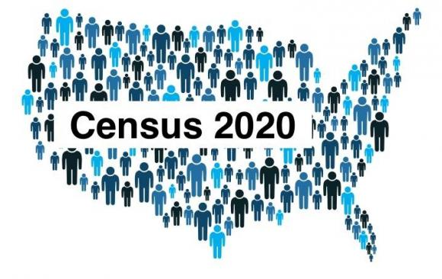
Local Re-Precincting
Municipalities have the responsibility of establishing ward & precinct boundaries.
Every ten years after the Federal Census, every Town and City(except Boston) in Massachusetts must review the results of population count and submit a precinct map for approval by the State.

Slide 6
Goals of Re-Precincting
Evenly distribute and balance the population of the precincts
Ensure equal representation by Town Meeting Members
Considering the neighborhoods, and geographic dividing lines

Slide 7
What is a Precinct?
A precinct is the smallest geographically bounded unit used for state election purposes.
No precinct may contain more than 4,000 residents/inhabitants

Slide 8
The Guidelines and Parameters of the Reprecincting Process
Census identified blocks cannot be split and the census numbers are the only ones that may be used.
Every precinct’s population must ultimately be within five percent (5%) range provided of the target precinct population for that town as established by the State. If a Town’s precincts do not fall within the target range, “reprecincting” consisting of redrawing the precinct lines, is required.
No precinct may contain more than 4,000 residents/inhabitants.

Slide 9
The Guidelines and Parameters of the Reprecincting Process (continued):
Each new precinct must be “composed of compact and contiguous territory”
Precincts must be bounded by the center-line of streets or other well-defined boundaries such as streams or other bodies of water, railroad tracks, power lines or other clearly visible geographic figures
Every precinct’s population must be within five percent(5%) of the average precinct population for the town.

Slide 10
Impacts of Reprecincting, Massachusetts General Laws Ch. 54, Section 6 and Milton’s Charter, Section 1 as amended
Voters in precincts that are changed must be notified in writing of the change to their voting precinct and the resultant polling location.
Reprecincting, changing the precinct borders, requires that the entire group of Town Meeting seats in that precinct must be elected to represent the newly drawn precinct. For Milton that equates to 30-33 seats open for election per precinct. Town Meeting Members will be elected in each of the precincts to three-, two- and one-year terms determined as follows: the candidates with the highest number of votes will be elected for the three-year term seats, the next group of winning candidates will be elected to the two-year term seats and the final group of winning candidates will be elected to the one-year term seats.
In any precinct where the precinct lines are not changed from the current configuration, there will be open seats for three-year terms.

Slide 11
2020 Federal Data for Milton
Population
2010: 27003
2020: 28630
6% Increase in population

Slide 12

2020 Goals for Re-Precincting
Retain precinct lines established in 2010
Minimize changes
Retain 10 Precincts

Slide 13
2020 Precinct Population Using 2010 Boundaries
Precinct 1 2823
Precinct 2 2857
Precinct 3 3012
Precinct 4 2933
Precinct 5 2859
Precinct 6 2961
Precinct 7 2698
Precinct 8 2960
Precinct 9 2868
Precinct 10 2659
TOTAL 28630

Slide 14
2020 Target Population:
2860
Minimum:
2,720
Maximum:
3,006
Precinct 1 2823
Precinct 2 2857
Precinct 3 3012 Over Maximum by 6
Precinct 4 2933
Precinct 5 2859
Precinct 6 2961
Precinct 7 2698 Under Minimum by 22
Precinct 8 2960
Precinct 9 2868
Precinct 10 2659 Under Minimum by 61
TOTAL 28630

Slide 15
State Proposal

Slide 16
State Proposal
6 Precincts Effected: 1, 3, 5, 6, 7 & 10
Precincts 1 & 5 Move Trout Brook, Myers Lane, part of Robbins Street and part of Canton Ave out of P1 into P5
Precincts 3 & 6 Move the triangle east of Dudley Lane to the intersection of Adams and Centre from P3 into P6
Precincts 6 & 7 Move boundary from the middle of Plymouth Ave to the middle of Governors Road
Precincts 5 & 10 Move Fairmount Ave to Cushing Road from P5 into P10

Slide 17
Precinct 1 | 2753
Precinct 2 | 2857
Precinct 3 | 2920
Precinct 4 | 2933
Precinct 5 | 2764
Precinct 6 | 2912
Precinct 7 | 2839
Precinct 8 | 2960
Precinct 9 | 2868
Precinct 10 | 2824
TOTAL | 28630
State Proposal

Slide 18
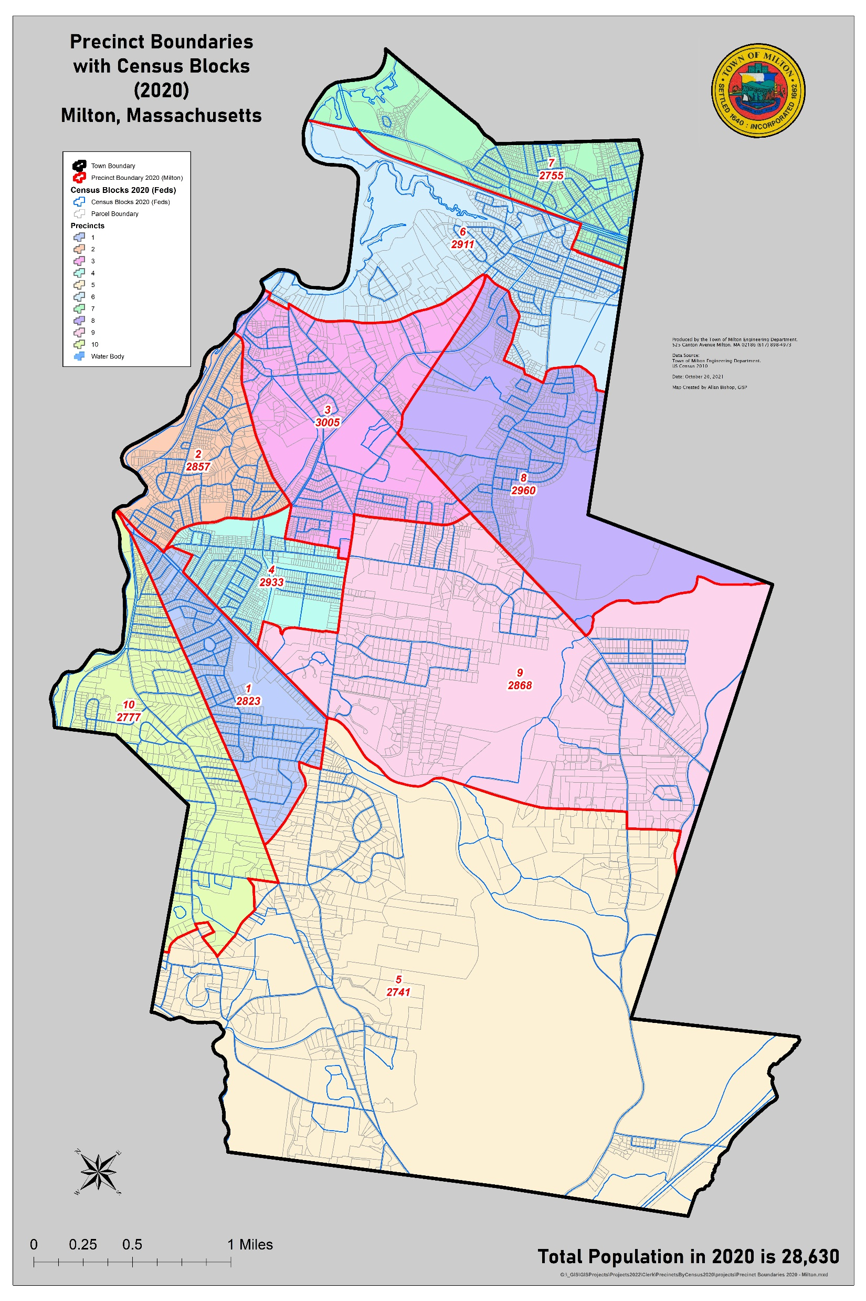
Town Proposal

Slide 19
Town Proposal
5 Precincts Affected: 3, 5, 6, 7 & 10
Precincts 3 & 6 Move block at High Street out of P3 into P6
Precincts 6 & 7 Make Southeast expressway the boundary. Move Guilford Road from P6 into P7
Precincts 5 & 10 Move Fairmount Ave to Cushing Road from P5 into P10
Precinct 10 & 5 Move triangle block at the Atherton Street & Bradlee Road intersection from P10 to P5
Precinct 10 & 5 Move block at Brush Hill Rd and Cushing Rd from P10 to P5

Slide 20
Town Proposal
Precinct 1 2823
Precinct 2 2857
Precinct 3 3005
Precinct 4 2933
Precinct 5 2741
Precinct 6 2911
Precinct 7 2755
Precinct 8 2960
Precinct 9 2868
Precinct 10 2777
TOTAL 28630
A

Slide 21
Impact of Town Proposal
The entire group of Town Meeting seats in Precinct 3, 5, 6, 7 & 10 must be elected in the April 2022 Town Election to represent the newly drawn precincts. This is approximately 132 seats
Precincts where the precinct lines remain the same, there will be open seats for the Town Meeting three-year term or any other vacancies .
Voters in precincts that are changed must be notified in writing of the change to their voting precinct and the resultant polling location

Slide 22
What Happens after the Select Board Votes
After local approval, the town clerk must give written notice of the division, submit maps and required paperwork to the Local Election Districts Review Commission (LEDRC).
Due date is October 30, 2021

Slide 23
The Local Election Districts Review Commission (LEDRC)
Is an independent commission charged with the responsibilities of overseeing, supervising and approving the divisions of cities and towns into precincts.
Consists of three members:
Attorney General (or designee)
State Secretary (or designee)
Governor Appointee
Authority to reject submitted plans and to require local authorities to reconfigure their precincts.

Slide 24
Notice to Public and Local Officials
Upon approval by LEDRC, the Select Board must publish a map or description of the new precincts.
Copies of the map must be sent to the election officials and the Board of Assessors.
Copies must be posted in public places in every precinct as determined by the Select Board.

Slide 26
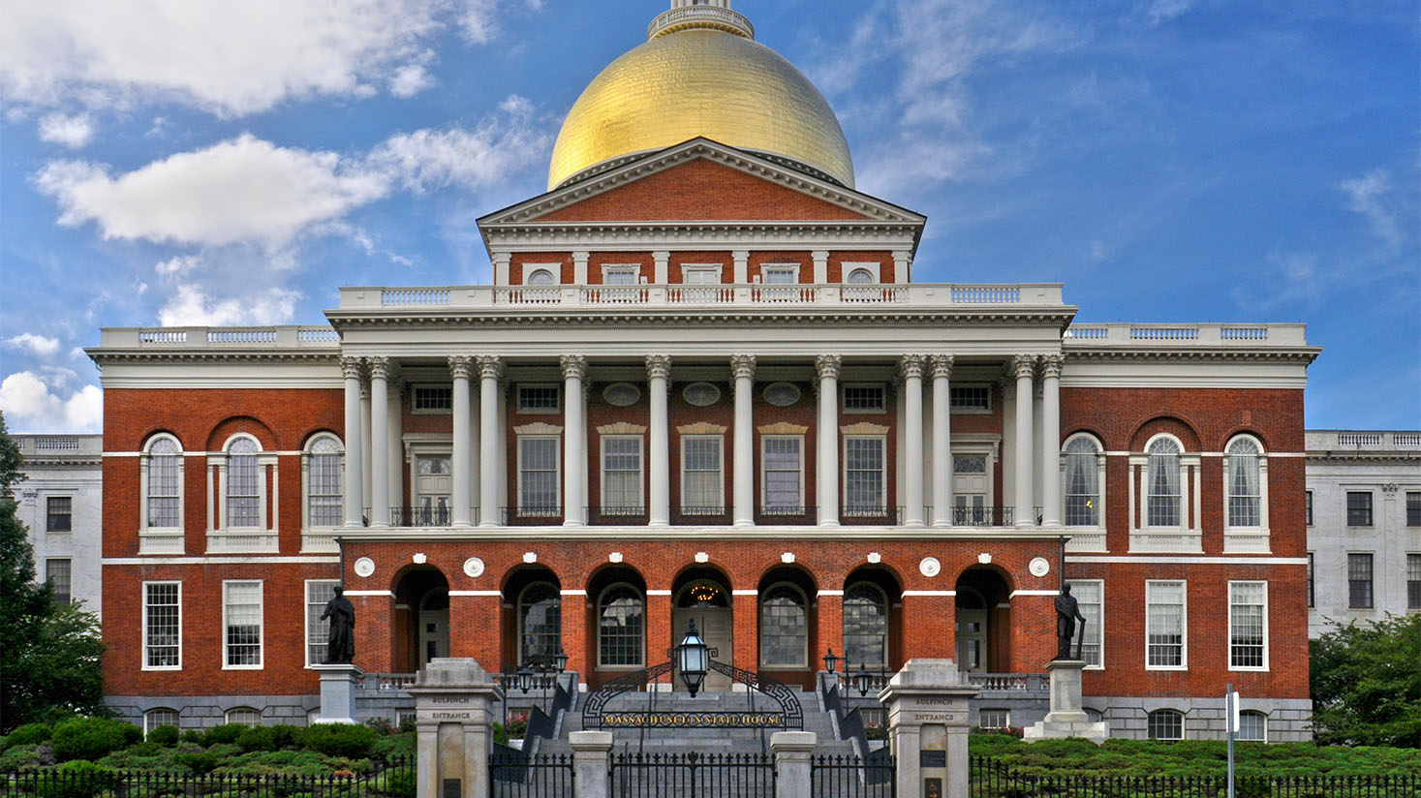
2021 LEGISLATIVE REDISTRICTING
UPDATED
December 7, 2021

Slide 27
TOWN OF MILTON LEGISLATIVE DISTRICTS
CONGRESSIONAL
7TH District
8TH District
GOVERNORS COUNCIL - 2ND District
SENATE -Norfolk, Plymouth and Bristol District
HOUSE
12TH Suffolk District
7TH Norfolk District

Slide 28
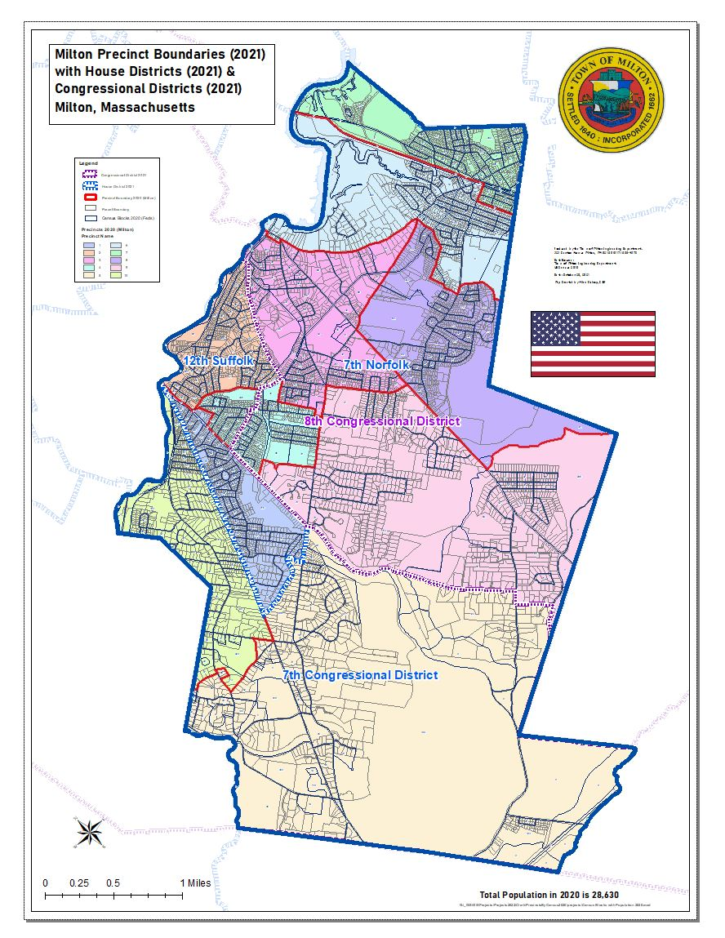

Slide 29
Impact of Legislative Redistricting
Precinct 4 will be divided into two sub-Precincts
4A will be in the 7th Congressional Districts & 12th Suffolk State Representative District
4B will be in the 8th Congressional District & 7 Norfolk State Representative District
Precinct 2 will move from the 8th to the 7th Congressional District

Slide 30
What is a sub-precinct?
A sub-precinct is a section of a precinct.

Slide 31

PRECINCT 4
Sub-precincts
PRECINCT
4 A
PRECINCT
4 B

Slide 32
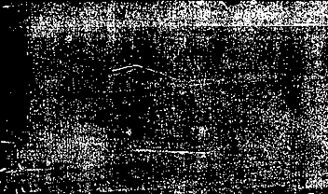

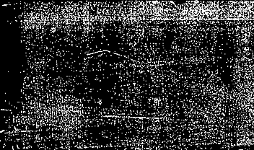
PRECINCT CHANGES
Within the Legislative Districts

Slide 33
LEGISLATIVE DISTRICTS IMPACTED
CONGRESSIONAL
7TH District
8TH District
STATE REPRESENTATIVE
12TH Suffolk District
7TH Norfolk District

Slide 34
7Th & 8Th Congressional Districts Populations
 | 7th Congressional | 8TH Congressional
Precinct 1 | 2823
Precinct 2 | 2857
Precinct 3 |  | 3005
Precinct 4 A | 1235
Precinct 4B |  | 1698
Precinct 5 | 2741
Precinct 6 |  | 2911
Precinct 7 |  | 2755
Precinct 8 |  | 2960
Precinct 9 |  | 2868
Precinct 10 | 2777
TOTAL | 12433 | 16197
TOTAL TOWN POPULATION: 28,630

Slide 35
12Th Suffolk & 7Th Norfolk State Representative District Populations
 | 12th Suffolk | 7th Norfolk
Precinct 1 | 2823
Precinct 2 | 2857
Precinct 3 |  | 3005
Precinct 4 A | 1235
Precinct 4B |  | 1698
Precinct 5 |  | 2741
Precinct 6 |  | 2911
Precinct 7 |  | 2755
Precinct 8 |  | 2960
Precinct 9 |  | 2868
Precinct 10 |  | 2777
TOTAL | 6915 | 21715
TOTAL TOWN POPULATION: 28,630

Slide 36
7TH CONGRESSIONAL DISTRICT
Current Precincts
1, 5, 10
New Precincts
1, 2, 4A, 5, 10
* Gain Precinct(s) 2 & half of Precinct 4(4A)

Slide 37
Current Precincts
2, 3, 4, 6, 7, 8, 9
New Precincts
3, 4B, 6, 7, 8, 9
8TH CONGRESSIONAL DISTRICT
* Lose Precinct 2 & half of Precinct 4 (4A)

Slide 38
12TH SUFFOLK STATE REPRESENTATIVE LEGISLATIVE DISTRICT
Current Precincts
1, 2
New Precincts
1, 2, 4A
* Gain half of Precinct 4 (4A)

Slide 39
7TH NORFOLK STATE REPRESENTATIVE LEGISLATIVE DISTRICT
Current Precincts
3, 4 , 5, 6, 7, 8, 9, 10
New Precincts
3, 4B, 5, 6, 7, 8, 9, 10
* Lose half of Precinct 4 (4A)

Slide 40

Effective Date of Re-Precincting & Re-Districting
December 31,2021

